Slide 1
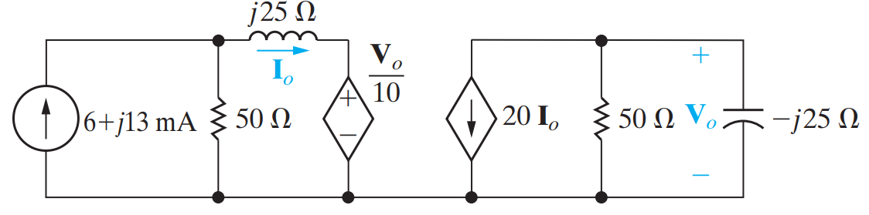
Problem 1
Use the node-voltage method to find $V_{o}$ and $I_{o}$ in the circuit seen in Fig.

Slide 2
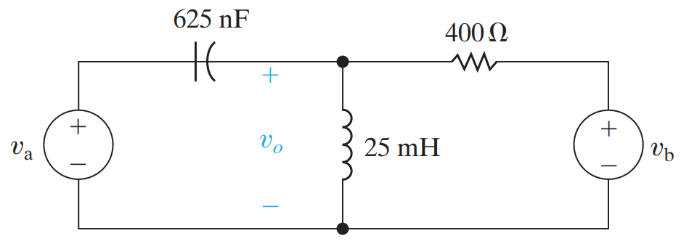

Problem 2
Use the mesh-current method to find the steady-state expression for in the circuit in Fig.
$$v_{a}=18\sin{4000t} V$$
$$v_{b}=12\cos{4000t} V$$

Slide 3
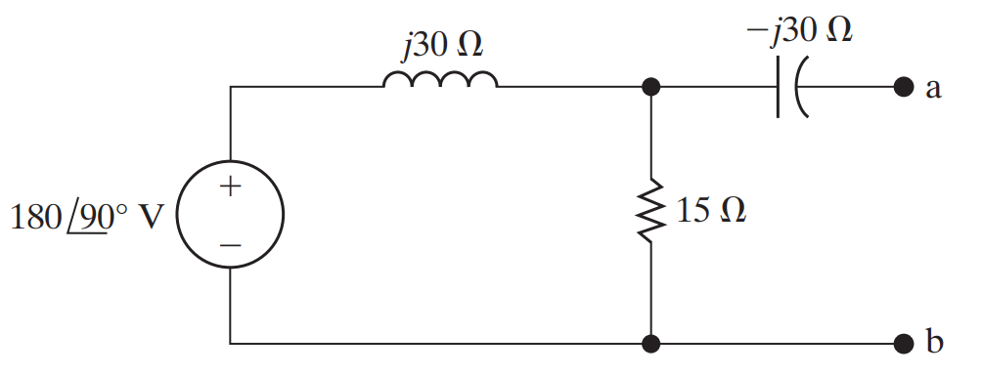
Problem 3
Use source transformations to find the Norton equivalent circuit with respect to the terminals a,b for the circuit shown in Fig.

Slide 4
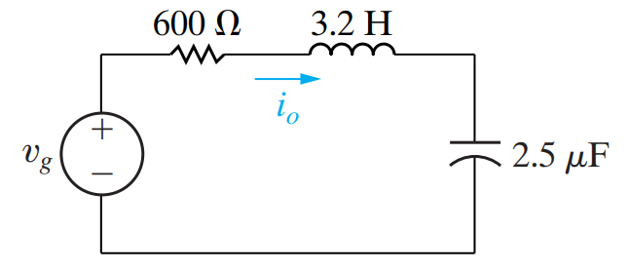
Problem 4
The circuit shown in Fig is operating in the sinusoidal steady state. Find the value $ω$ of if
$$i_{o}=40\sin\left(ωt+21.87°\right) mA$$
$$v_{g}=40\cos\left(ωt−15°\right) V$$

Slide 5
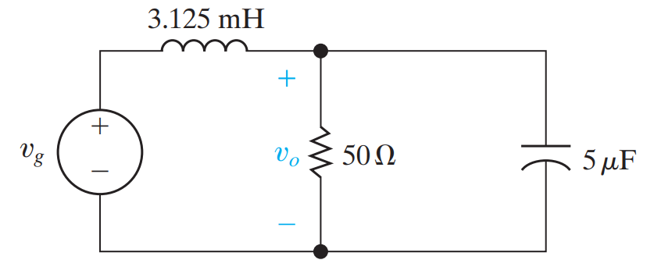
Problem 5
The circuit in Fig. is operating in the sinusoidal steady state. Find the steady-state expression for $v_{o}\left(t\right)$ if $v_{g}=60\sin{8000t} V$

Slide 6
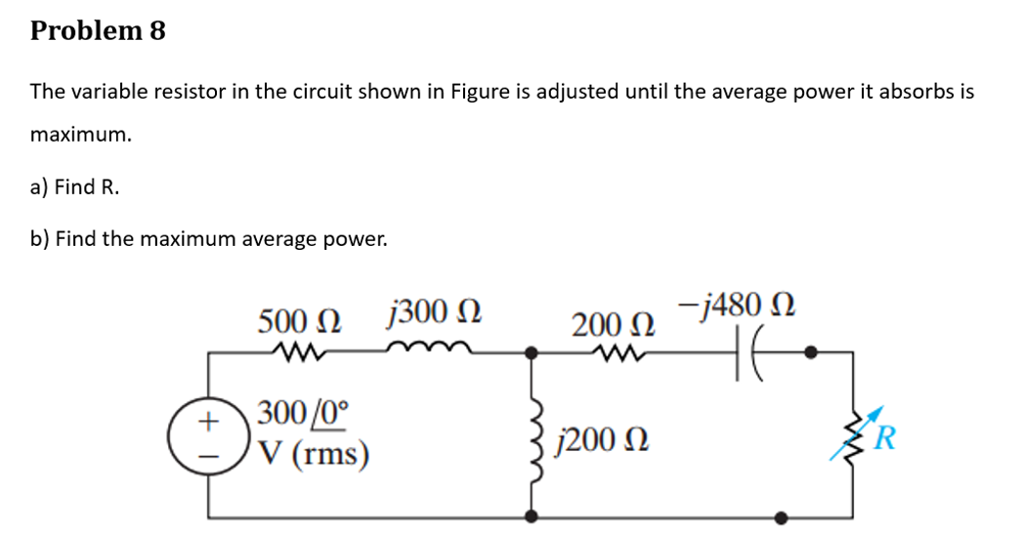
Problem 6

